Slide 1
Books Clustering

Slide 2
Team Members
Ahmed Badawy
Anas Elbattra
Esmael Ezz
Yousef Shindy

Slide 3
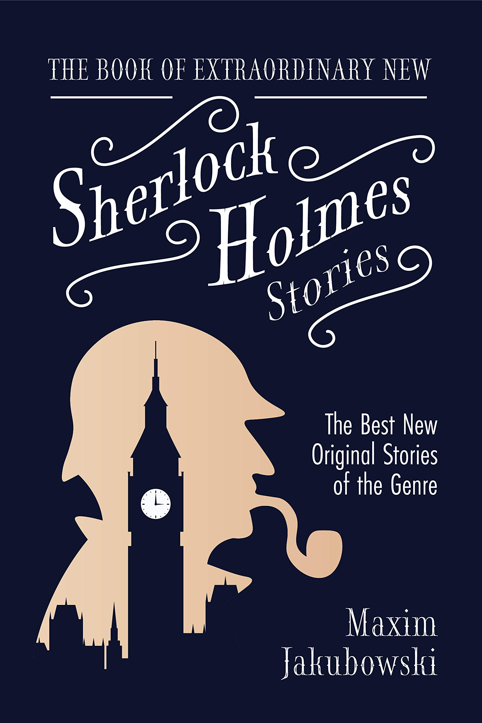
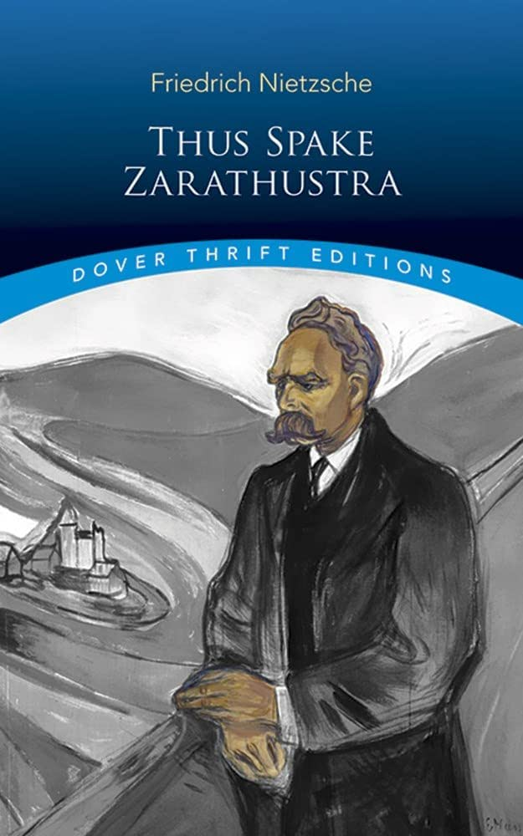
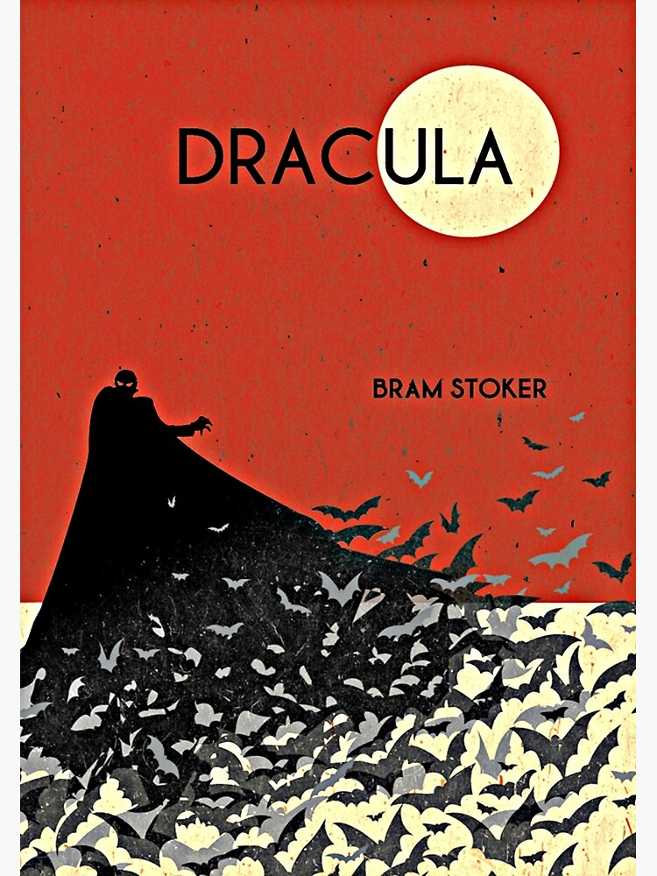
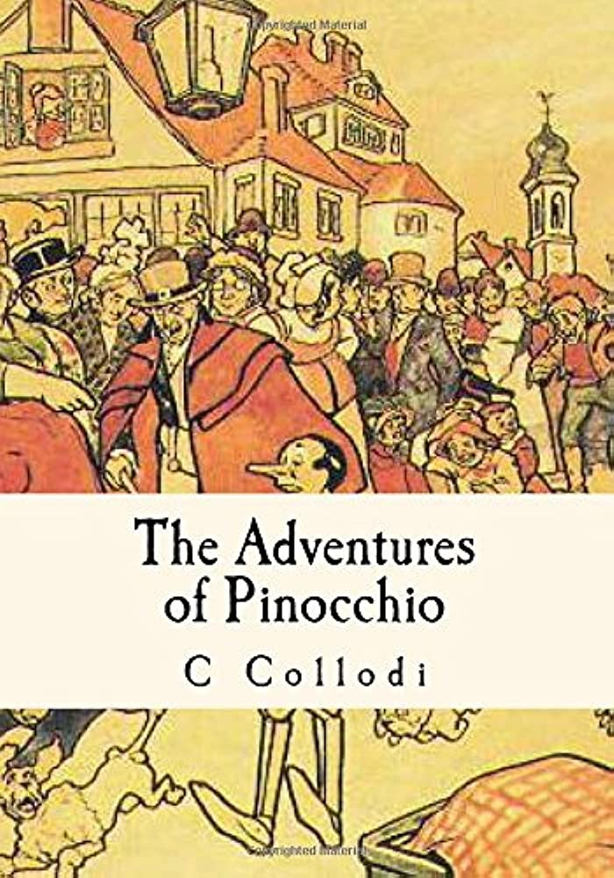
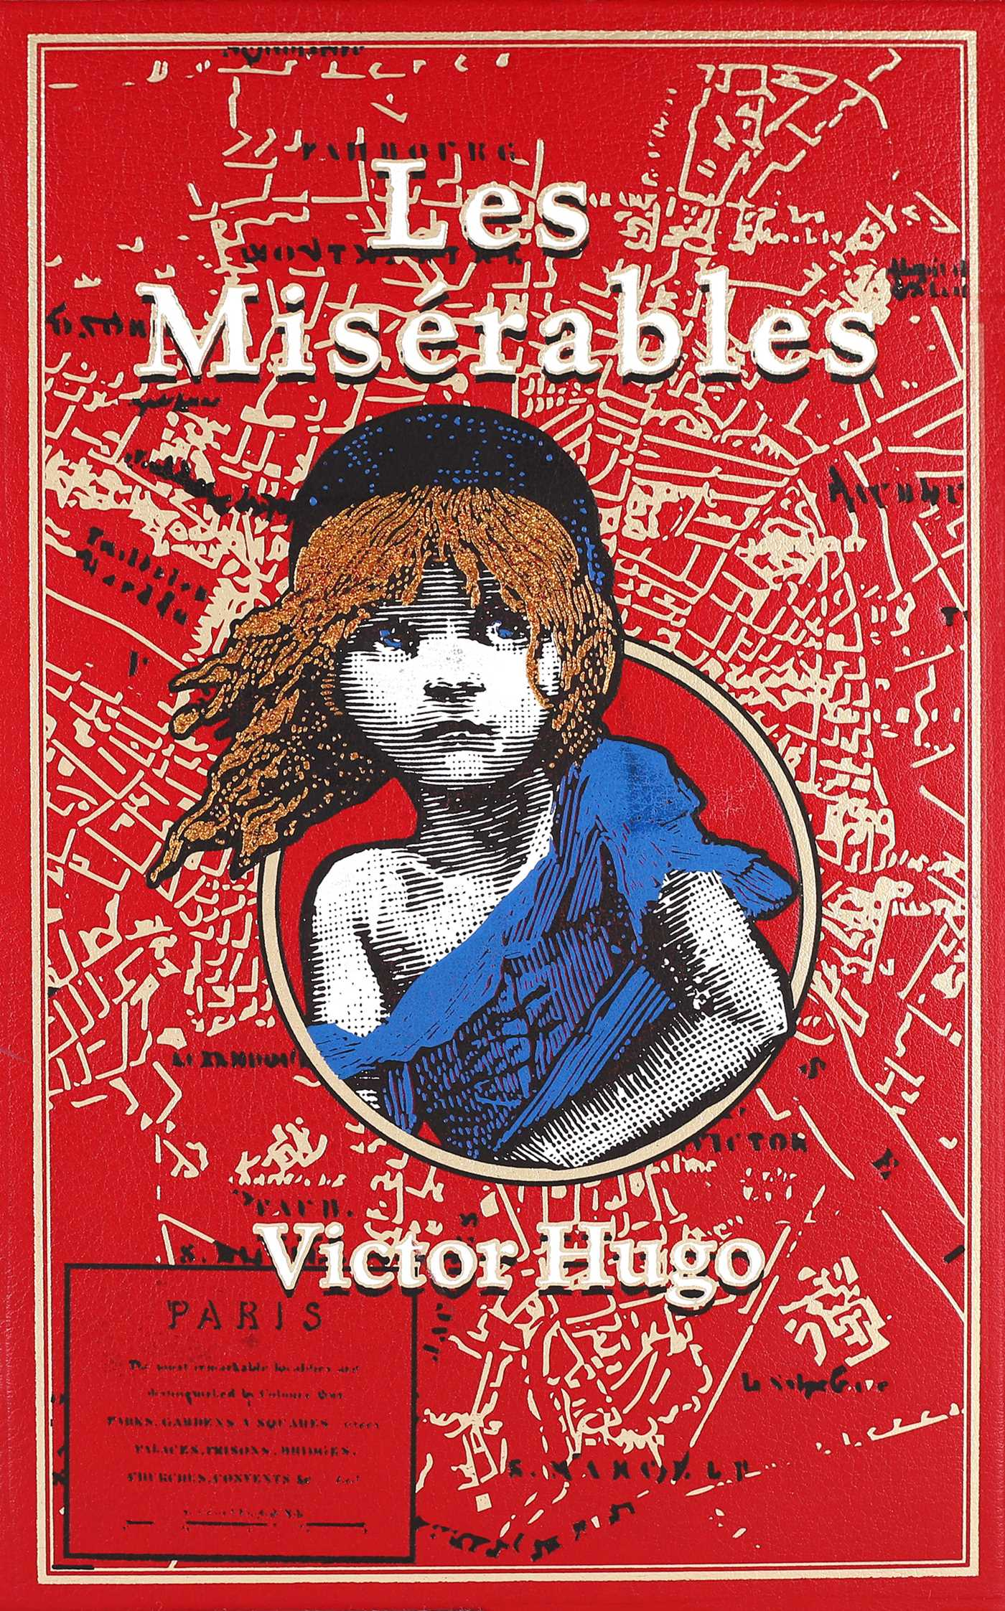
Books

Slide 4
Data
The Adventures of Pinocchio.
Les Misérables
Dracula
Thus Spake Zarathustra
The Adventures of Sherlock Holmes

Slide 5
Preprocessing
Tokenize The Book.
Remove Stop Words.
Split each book to 200 samples.
Lemmatization.
Combine the five books.

Slide 6
Feature Engineering
Bag of Words
TF-IDF
LDA

Slide 7
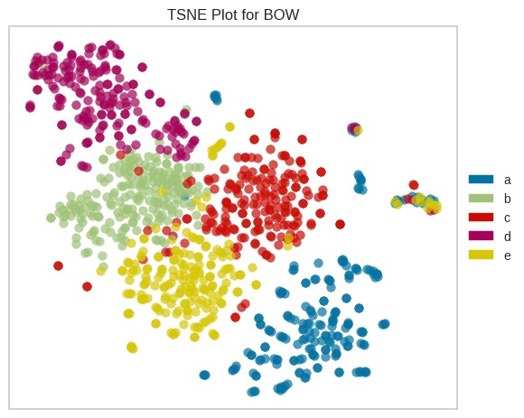
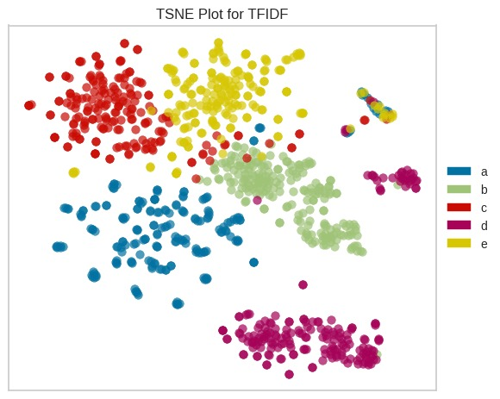
Visualization

Slide 8
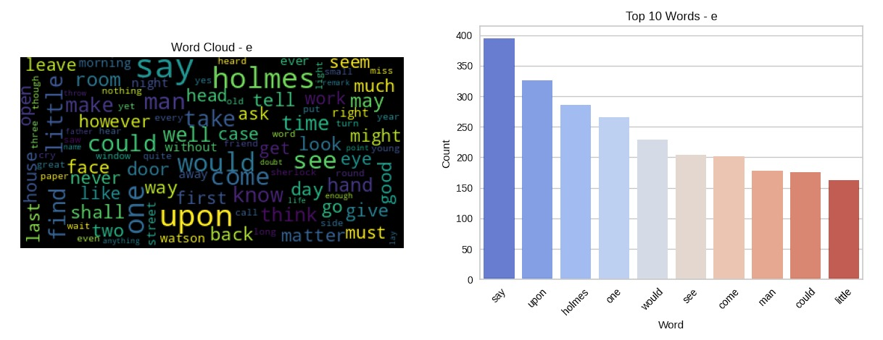
Visualization

Slide 9
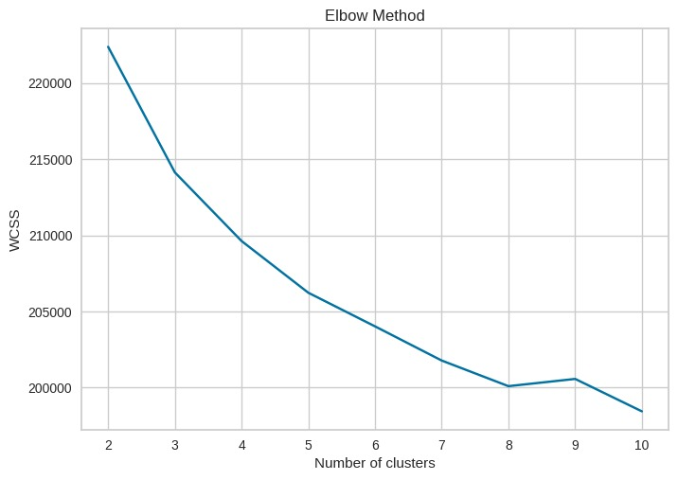
Visualization

Slide 10
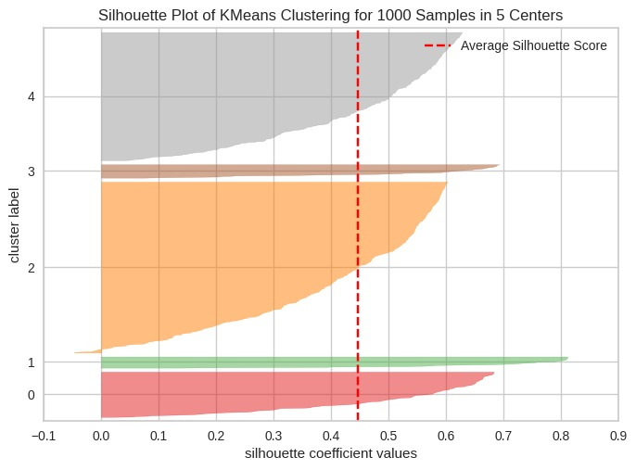
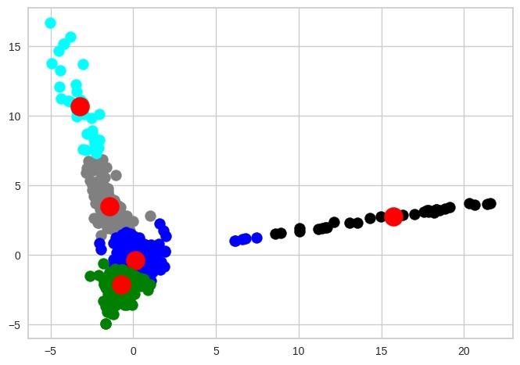
Visualization
Kmeans BOW

Slide 11
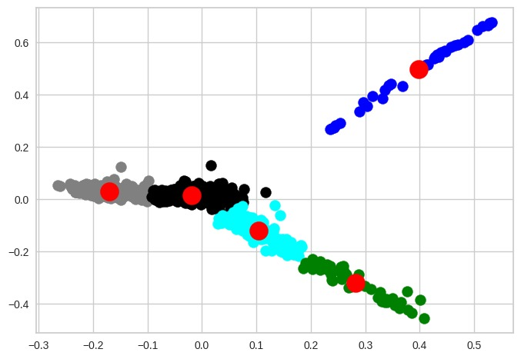
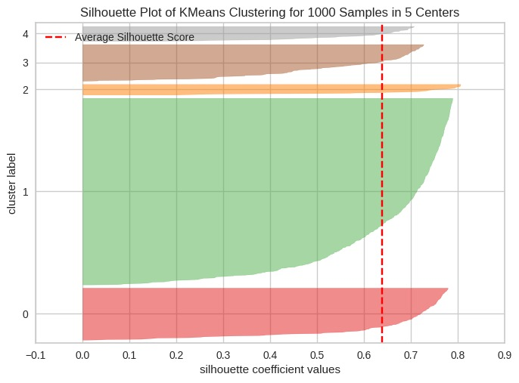
Visualization
Kmeans TF-IDF

Slide 12
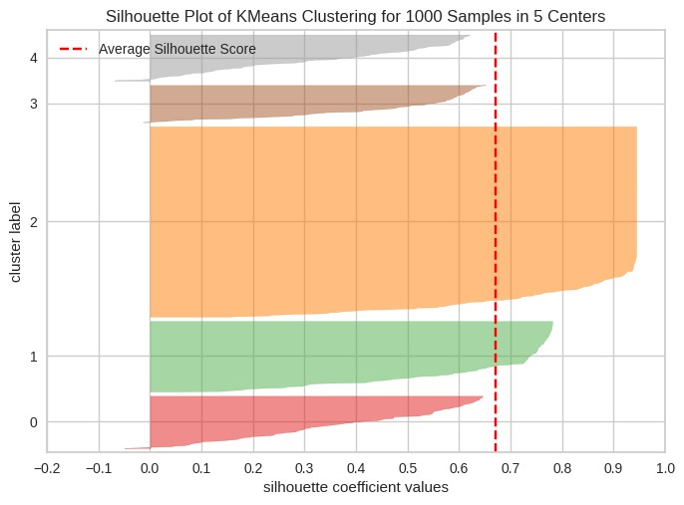
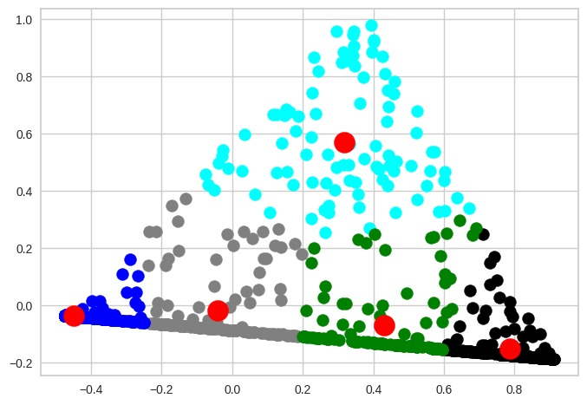
Visualization
Kmeans LDA

Slide 13
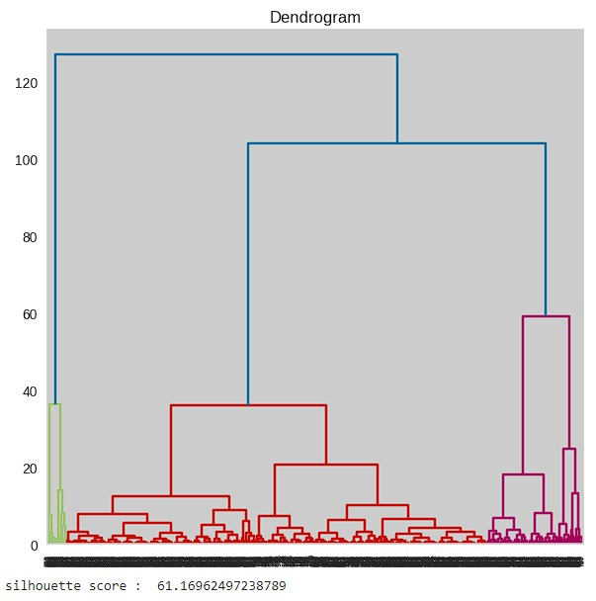
Visualization

Slide 14
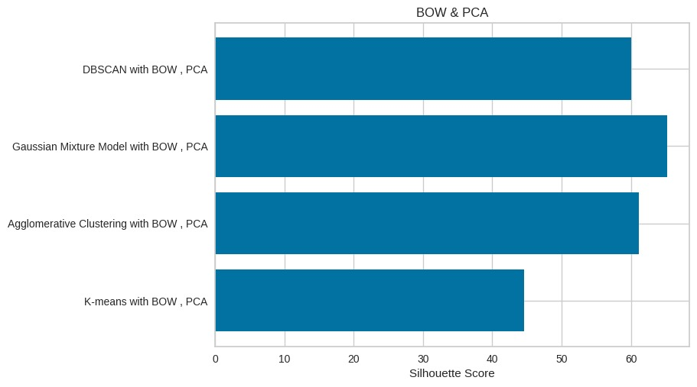
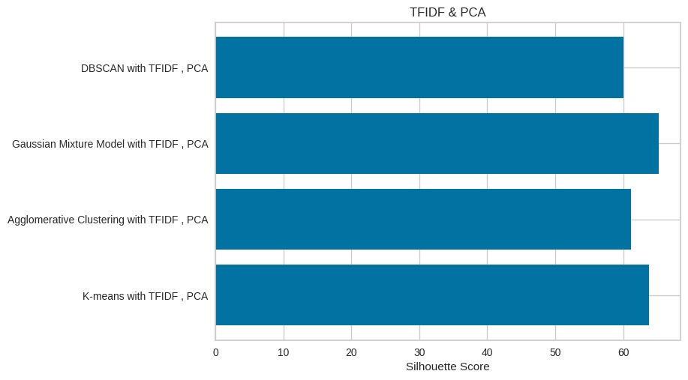
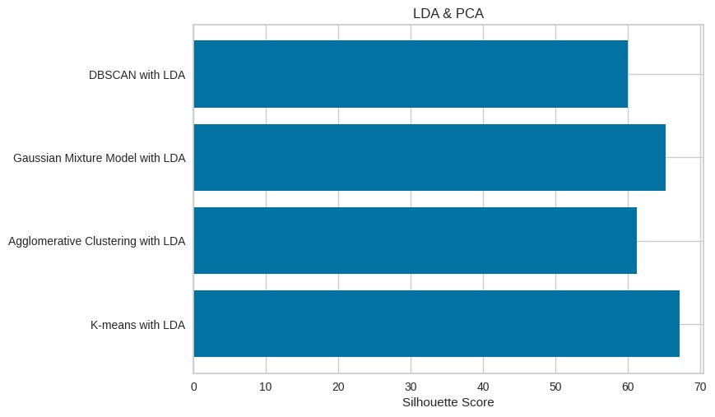
Visualization

Slide 15
Modelling & Evaluation
Model | Bag of Words | TFIDF | LDA
K-Means | silhouette: 44.57% Kappa: 0.24 | silhouette: 63.77% Kappa: 0.3712 | silhouette: 67.08% Kappa: 0.0237
AGG | silhouette: 61.16% Kappa: 0.0862 | silhouette: 61.16% Kappa: 0.0862 | silhouette: 61.16% Kappa: 0.0862
GMM | silhouette: 65.19% Kappa: 0.15125 | silhouette: 65.19% Kappa: 0.15125 | silhouette: 65.19% Kappa: 0.15125
DBSCAN | silhouette: 59.99% Kappa: 0.0401 | silhouette: 59.99% Kappa: 0.0401 | silhouette: 59.99% Kappa: 0.0401

Slide 16
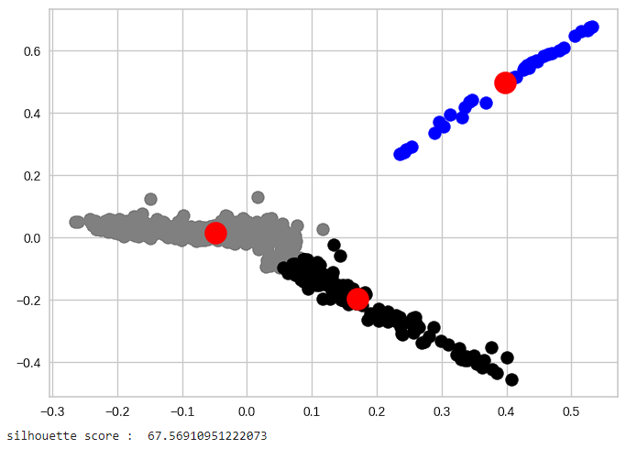
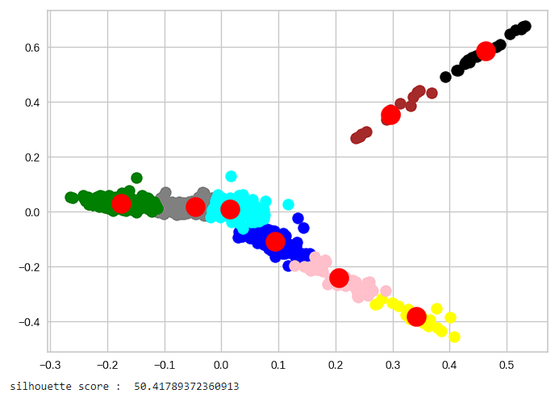
Error Analysis
We changed the number of clusters of the champion model to K = 8 as determined by the elbow method seen before but it gave us a lower score than K = 5 then we tried K = 3 which gave us a higher score than K = 5 as expected.

Slide 17
Thank you

